Slide 1
Oracle 12c: SQL
Chapter 7
User Creation and Management
©2016. Cengage Learning. All rights reserved.

Slide 2
Objectives
Explain the concept of data security
Create a new user account
Identify two types of privileges: system and object
Grant privileges to a user
Address password expiration requirements
Change the password of an existing account
©2016. Cengage Learning. All rights reserved.

Slide 3
Objectives (continued)
Create a role
Grant privileges to a role
Assign a user to a role
View privilege information
Revoke privileges from a user and a role
Remove a user and roles
©2016. Cengage Learning. All rights reserved.

Slide 4
Data Security
User accounts provide a method of authentication
  They can grant access to specific objects
  They identify owners/users of objects
©2016. Cengage Learning. All rights reserved.

Slide 5
Creating a User
The CREATE USER command gives each user a user name and password
NOTE :In order for you to do this you must use an account with DBA privileges.
2nd NOTE: Sometimes companies have specific format for user names – jsullivan, josh.sullivan, js123435
©2016. Cengage Learning. All rights reserved.

Slide 6

PASSWORDS
Passwords are created using IDENTIFIED BY and they are case sensitive.
PASSWORD EXPIRE – allows the user to change the password after logging in
But rthomas can’t login yet! The system would prompt him to change his password, but then state “login denied”!

Slide 7
Password Management
To change a user password, use the PASSWORD command or the ALTER USER command
©2016. Cengage Learning. All rights reserved.

Slide 8
Assigning User Privileges
There are two types of privileges
System privileges
  Allow access to the database and execution of DDL operations (eg. CREATE, ALTER, DROP)
Object privileges
  Allow a user to perform DML and query operations (eg. INSERT, UPDATE)
©2016. Cengage Learning. All rights reserved.

Slide 9
Assigning User Privileges (continued)
Even with a valid user name and password, a user still needs the CREATE SESSION privilege to connect to a database
©2016. Cengage Learning. All rights reserved.

Slide 10
System Privileges
Affect a user’s ability to create, alter, and drop objects
Use of ANY keyword with an object privilege (INSERT ANY TABLE) is considered a system privilege
List of all available system privileges available through SYSTEM_PRIVILEGE_MAP
©2016. Cengage Learning. All rights reserved.

Slide 11
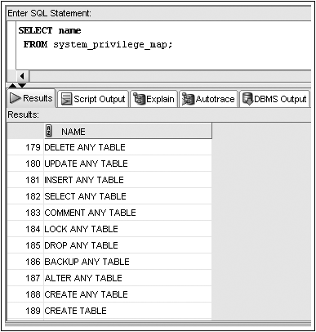
SYSTEM_PRIVILEGE_MAP
©2016. Cengage Learning. All rights reserved.

Slide 12
Granting System Privileges
System privileges are given through the GRANT command
©2016. Cengage Learning. All rights reserved.

Slide 13
Granting System Privileges (continued)
GRANT clause – identifies system privileges being granted
TO clause – identifies receiving user or role
WITH ADMIN OPTION clause – allows a user to grant privilege to other database users
©2016. Cengage Learning. All rights reserved.

Slide 14
Object Privileges
When a user creates an object, they automatically have all the object privileges associated with that object. Other users must be granted privileges to do so.
  SELECT – display data from table, view, or sequence
  INSERT – insert data into table or view
  UPDATE – change data in a table or view
  DELETE – remove data from a table or view
  ALTER – change definition of table or view
  INDEX – create an index for a table
  REFERENCES – user can reference a table when creating a FOREIGN KEY.
©2016. Cengage Learning. All rights reserved.

Slide 15
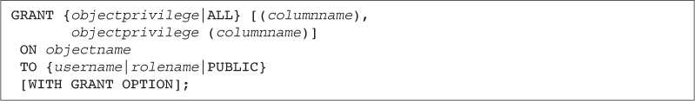
Granting Object Privileges
Grant object privileges through the GRANT command
©2016. Cengage Learning. All rights reserved.

Slide 16
Granting Object Privileges (continued)
GRANT clause – identifies object privileges
ON clause – identifies object
TO clause – identifies user or role receiving privilege
WITH GRANT OPTION clause – gives a user the ability to assign the same privilege to other users
©2016. Cengage Learning. All rights reserved.

Slide 17
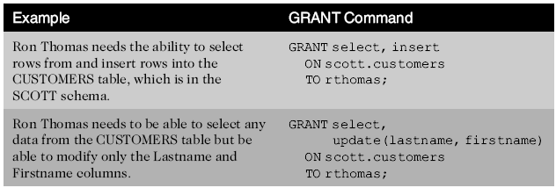

GRANT Command Examples
©2016. Cengage Learning. All rights reserved.

Slide 18

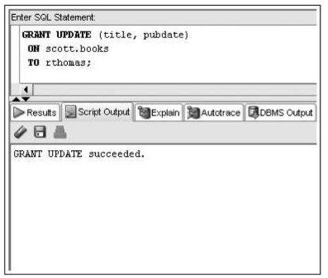
Oracle 11g: SQL

Slide 19
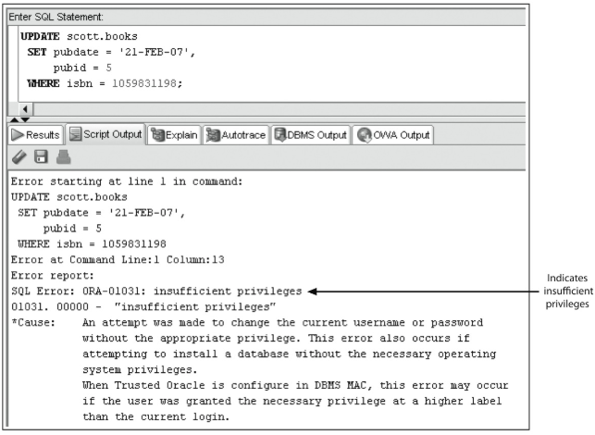
Oracle 11g: SQL

Slide 20
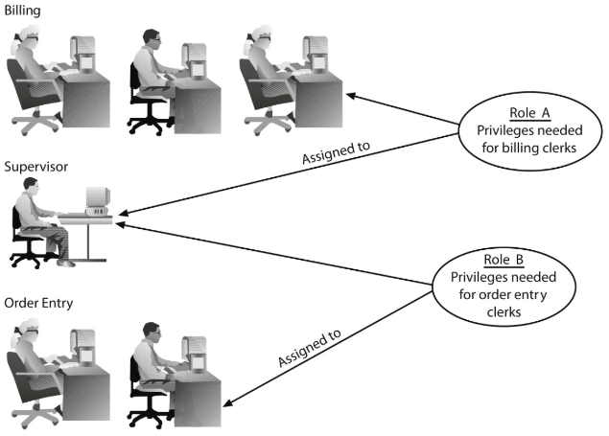
Utilizing Roles
A role is a group, or collection, of privileges
©2016. Cengage Learning. All rights reserved.

Slide 21
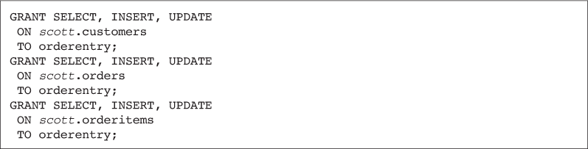
Utilizing Roles
©2016. Cengage Learning. All rights reserved.

Slide 22
Utilizing Roles (continued)
Roles can be assigned to users or other roles
©2016. Cengage Learning. All rights reserved.

Slide 23


Utilizing Roles (continued)
A user can be assigned several roles
All roles can be enabled at one time
. . .or one role can be a combination of other roles
©2016. Cengage Learning. All rights reserved.

Slide 24
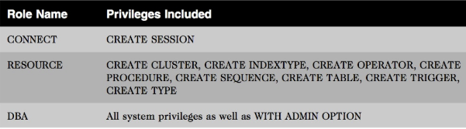
Predefined Roles
Oracle has a set of predefined roles already made
NOTE: The “Oracle Database Security Guide” lists all predefined roles.
©2016. Cengage Learning. All rights reserved.

Slide 25

Default Roles
Only one role can be designated as the default role for each user
Default role can be assigned through the ALTER USER command
©2016. Cengage Learning. All rights reserved.

Slide 26
Utilizing Roles (continued)
Roles can be modified with the ALTER ROLE command
Roles can be assigned passwords
©2016. Cengage Learning. All rights reserved.

Slide 27
Viewing Privilege Information
ROLE_SYS_PRIVS lists all system privileges assigned to a role
SESSION_PRIVS lists a user’s currently enabled roles
©2016. Cengage Learning. All rights reserved.

Slide 28
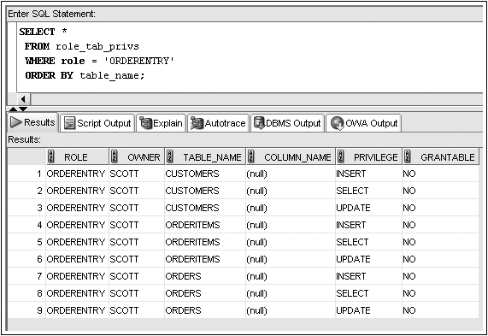
ROLE_TAB_PRIVS Example
©2016. Cengage Learning. All rights reserved.

Slide 29
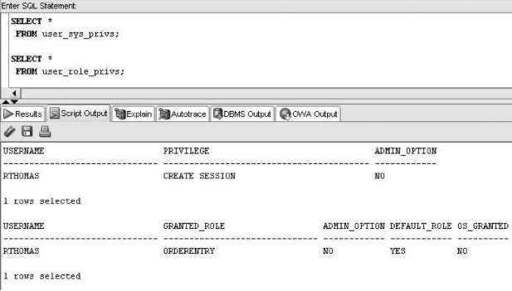

Slide 30
Removing Privileges and Roles
Revoke system privileges with the REVOKE command
©2016. Cengage Learning. All rights reserved.

Slide 31
Removing Privileges and Roles (continued)
Revoking an object privilege – if the privilege was originally granted using WITH GRANT OPTION, the effect cascades and is revoked from subsequent recipients
©2016. Cengage Learning. All rights reserved.

Slide 32
Removing Privileges and Roles (continued)
©2016. Cengage Learning. All rights reserved.

Slide 33


Oracle 11g: SQL

Slide 34
Dropping a Role
Users receiving privileges via a role that is dropped will no longer have those privileges available
©2016. Cengage Learning. All rights reserved.

Slide 35
Dropping a User
The DROP USER command is used to remove a user account
©2016. Cengage Learning. All rights reserved.

Slide 36
TRY IT OUT. . . .
Ron’s supervisor has just informed you that the correct spelling of Ron’s last name is Tomas, not Thomas. Drop the “rthomas” and create a new user with the correct spelling -“rtomas”
Oracle 11g: SQL

Slide 37
Summary
Database account management is only one facet of data security
A new user account is created with the CREATE USER command
  The IDENTIFIED BY clause contains the password for the account
System privileges are used to grant access to the database and to create, alter, and drop database objects
The CREATE SESSION system privilege is required before a user can access his account on the Oracle server
The system privileges available in Oracle 11g can be viewed through the SYSTEM_PRIVILEGE_MAP
©2016. Cengage Learning. All rights reserved.

Slide 38
Summary (continued)
Object privileges allow users to manipulate data in database objects
Privileges are given through the GRANT command
The ALTER USER command, combined with the PASSWORD EXPIRE clause, can be used to force a user to change her password upon the next attempted login to the database
The ALTER USER command, combined with the IDENTIFIED BY clause, can be used to change a user’s password
  Privileges can be assigned to roles to make the administration of privileges easier
©2016. Cengage Learning. All rights reserved.

Slide 39
Summary (continued)
Roles are collections of privileges
The ALTER USER command, combined with the DEFAULT ROLE keywords, can be used to assign a default role(s) to a user
Privileges can be revoked from users and roles using the REVOKE command
Roles can be revoked from users using the REVOKE command
A role can be deleted using the DROP ROLE command
A user account can be deleted using the DROP USER command
©2016. Cengage Learning. All rights reserved.

